Slide 1
Microsoft 365
Business Technical Fundamentals
Module 4: Deploying Office 365
Speaker Name
Date
Notes:
Welcome to module 4 of the Microsoft 365 Business Technical Fundamental Series

Slide 2
Microsoft 365 Business Deployment overview steps
Step 1
Step 2
Step 3
Step 4
Configure users
& policies
Deploy Office 365 Workloads & Clients
Deploy & manage Windows 10
Management & Troubleshooting
Notes:
<click>

Slide 3
Deployment Step 2 | Deploy Office 365
Step 1
Step 2
Step 3
Step 4
Configure users
& policies
Deploy Office 365 Workloads & Clients
Deploy & manage Windows 10
Management & Troubleshooting
Notes:
In this module we will be focusing on deploying office 365 workloads and clients.

Slide 4

Email deployment - options
Hybrid
Cloud only
Complex – Proceed with caution
Recommended for SMB Customers
Some user mailboxes hosted in an on-premises Exchange organization
Some user mailboxes hosted in Microsoft 365 Business
All users and mailboxes are hosted and managed in Microsoft 365 Business
Notes:
There are two ways to we can provide email with Office 365.
Hybrid deployment
Cloud only deployment
Hybrid deployment is flexible and has options that allow Enterprise customers complex scenario handling and long-term coexistence.
For Microsoft 365 Business customers, we recommend a Cloud only approach because it simplifies administration and lowers costs.
It’s important to note that Hybrid deployment is different from Hybrid migration in that Hybrid deployment is designed for long term coexistence with Exchange server on premises, which is not normally appropriate for SMB customers.

Slide 5
Email Migration Options
Option | What happens
IMAP Migration | Migrate mailbox data from IMAP-based email systems to Microsoft 365 Business using a web-based tool
Cutover migration | Migrate mailboxes from Exchange Server in a single cutover migration using a web-based tool
Staged migration | Perform a staged migration to migrate mailboxes with web-based migration tools and minimal changes to on-premises infrastructure.
Remote move migration | Migrate to Microsoft 365 Business in an Exchange hybrid deployment.
Manual migration | Users copy old email from an existing system to Microsoft 365 Business using Outlook
Notes:
The IMAP Migration method is generally suitable when migrating SMB customers that are not using Microsoft Exchange 2003 or newer. This includes Gmail, G Suite, Outlook.com, and Hotmail. The IMAP method case be used for Exchange server as well; however, the cutover or remove move may be more desirable.
A cutover migration can usually be done over a weekend and is suitable for SMB customers using Exchange Server 2003 or newer
Staged migration may be appropriate for SMB customers using legacy Exchange Server 2003/2007 where Hybrid is not possible, and that have too much data or not enough bandwidth for a cutover migration
A minimal Hybrid deployment can be used to quickly migrate Exchange mailboxes with maximum fidelity and minimum impact to end users. Hybrid involves additional steps that require planning and proper deployment by qualified resources.
A manual migration can be users where users configure Outlook to connect to both the source email system and Microsoft 365 Business at the same time then manually their email. This method shifts the work to the end users and may result in an inability to reply to old email.
https://docs.microsoft.com/en-us/Exchange/mailbox-migration/use-minimal-hybrid-to-quickly-migrate

Slide 6
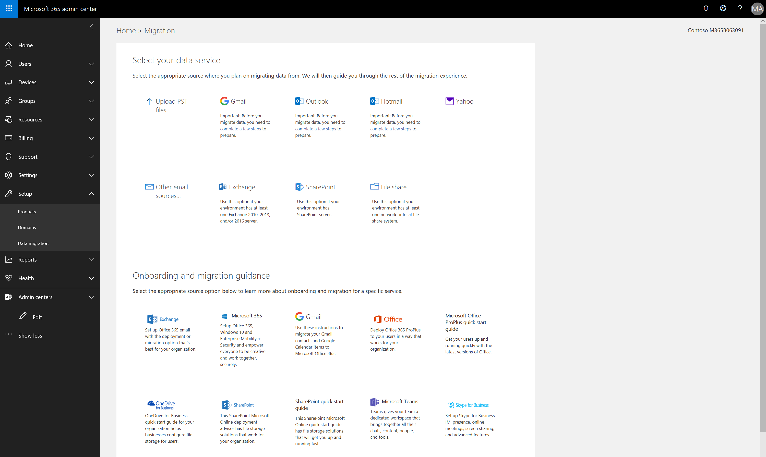
Notes:
Web based tools and guidance for email migration is available in the Admin portal under the Setup left hand navigation node.

Slide 7
OneDrive deployment
What you need to know
OneDrive client is automatically deployed to managed Windows clients in Microsoft 365 Business.
You can configure the service at https://admin.onedrive.com.
  Manage external sharing and notifications
  Control which users and devices can sync
  Block specific file types
  Control access based on location or app
Notes:
OneDrive is automatically deployed to managed Windows clients in Microsoft 365 Business, and you can configure the service via admin.onedrive.com

Slide 8
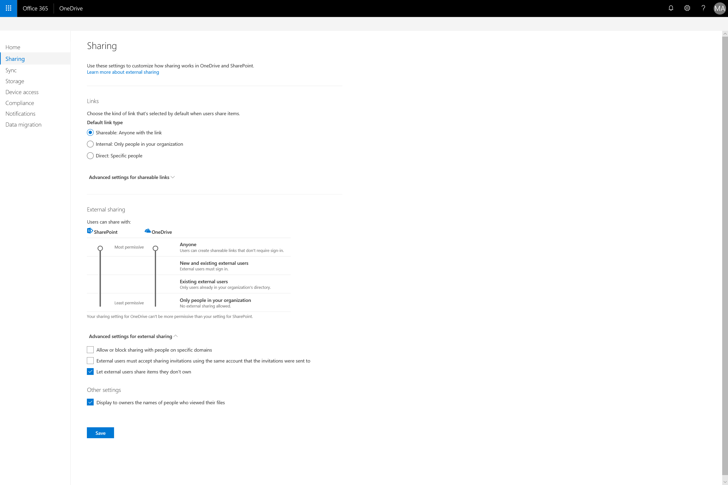
Notes:
Here we can set the sharing options for OneDrive.
We can:
Change the default sharing link
Specify how external content can be shared via SharePoint and OneDrive by adjusting the vertical sliders for each
As well as allow and block specific domain

Slide 9
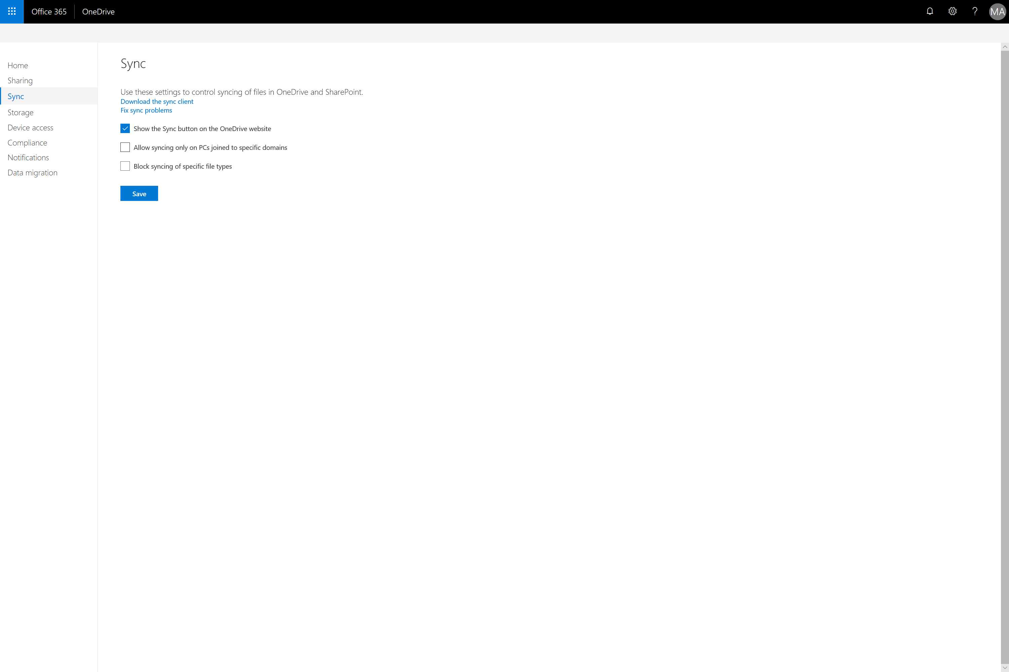
Notes:
The Sync page allows us to restrict sync to machines is a specific domain (by specifying domain GUIDs) and/or block specific file types (by specifying file extensions)

Slide 10
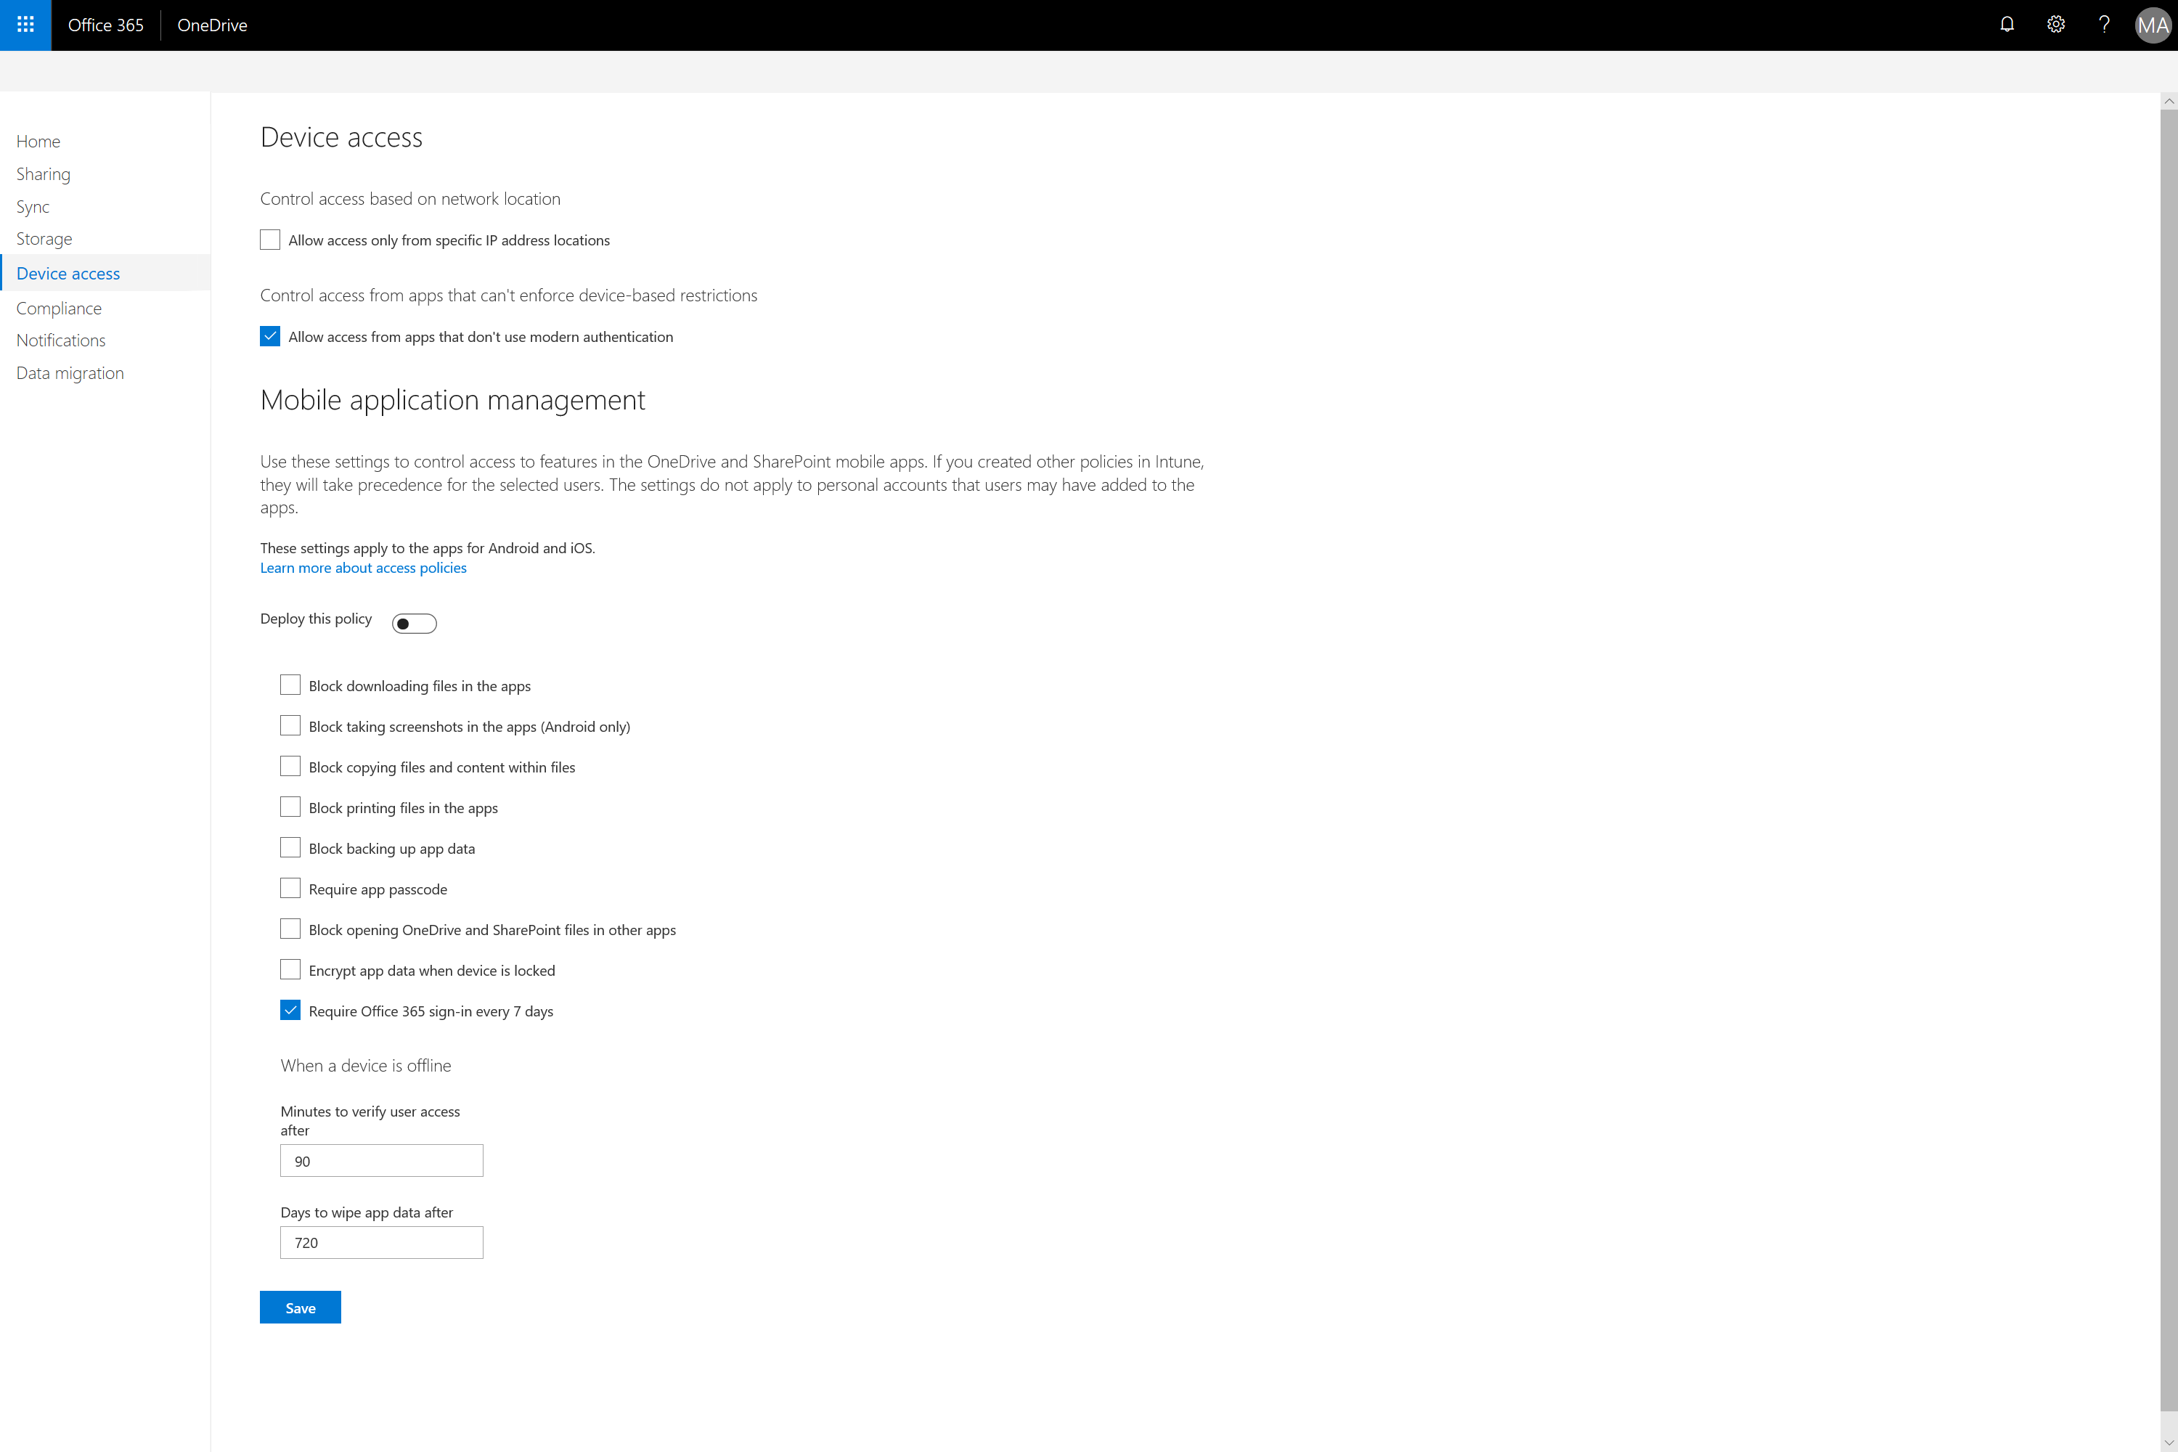
Notes:
The Device Access page allows up to control sync by IP address locations as well as configure a mobile application policy for OneDrive to configure OneDrive behavior on devices.
If we configure the policy here, it will create the policy and push to Intune for you after you activate the toggle ‘Deploy this policy’

Slide 11
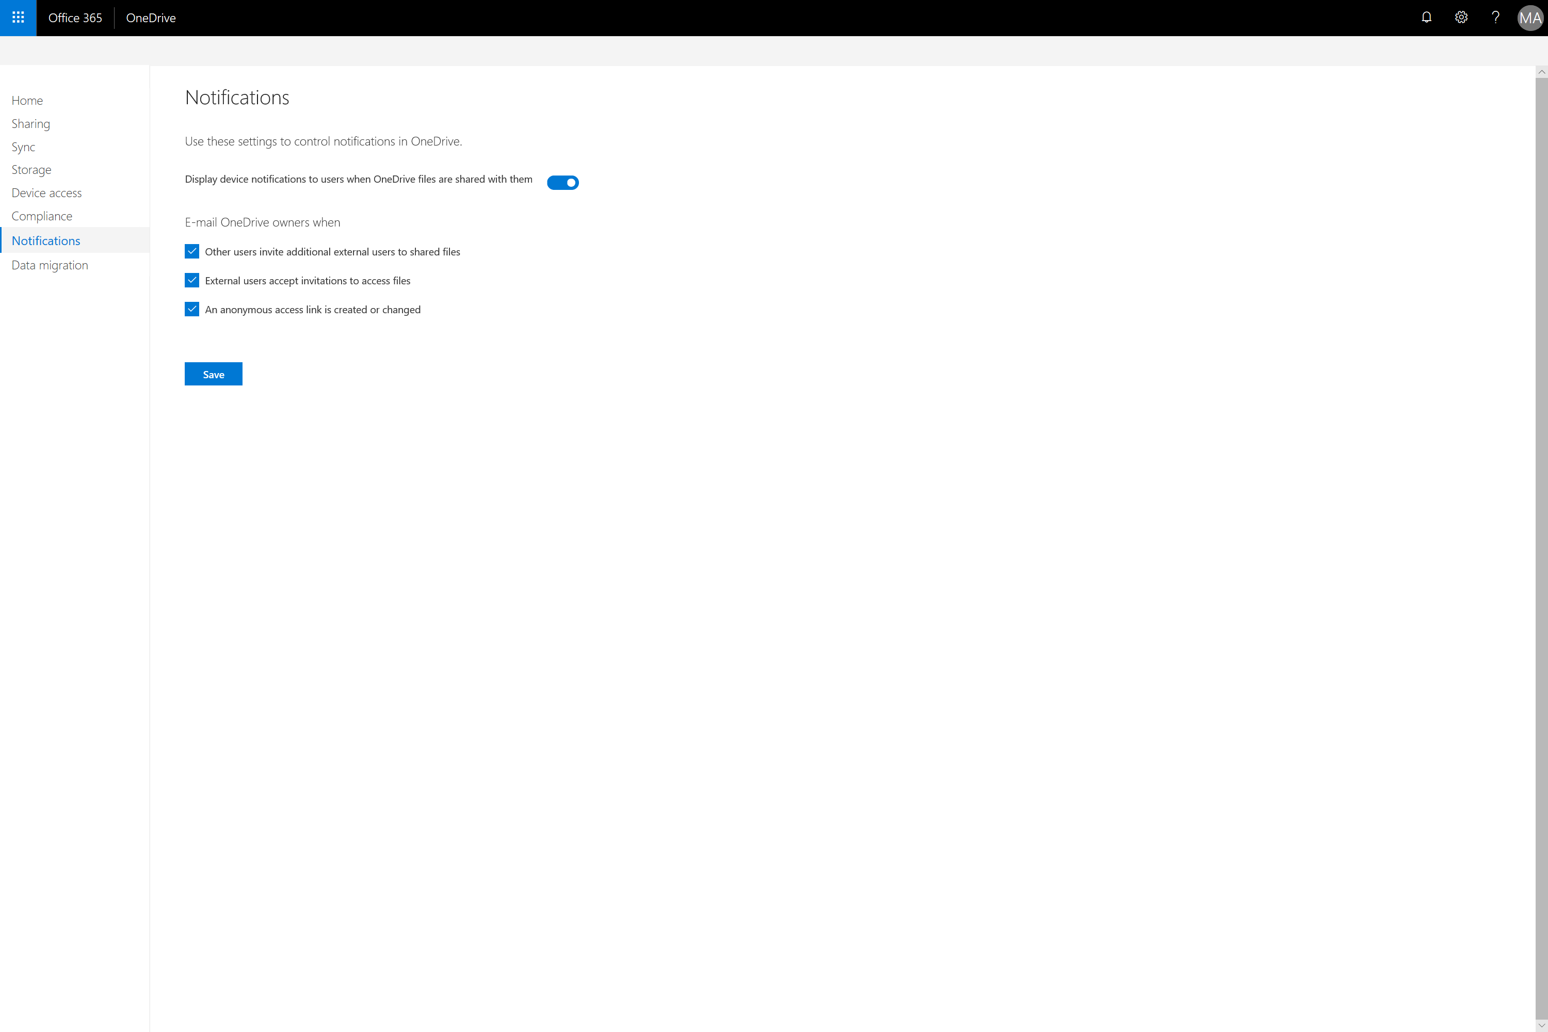
Notes:
The Notifications page allows us to control OneDrive notifications to users and owners

Slide 12

Teams deployment
What you need to know
The Teams client is not automatically deployed to managed Windows clients in Microsoft 365 Business.
Customers often need assistance to get started.
You can configure the service at https://admin.teams.microsoft.com.
  Meeting policies & settings
  Live event policies & recording
  Organization wide settings for Teams
  Messaging policies
Notes:
As the Teams client is not part of Office Click-to-run it will need to be installed separately, preferably via Intune.
Removed from slide
Phone plan options (Calling plan must be added to M365B)
-has been removed from this slide, when call plans can be added to M365B accounts please put this point back in

Slide 13
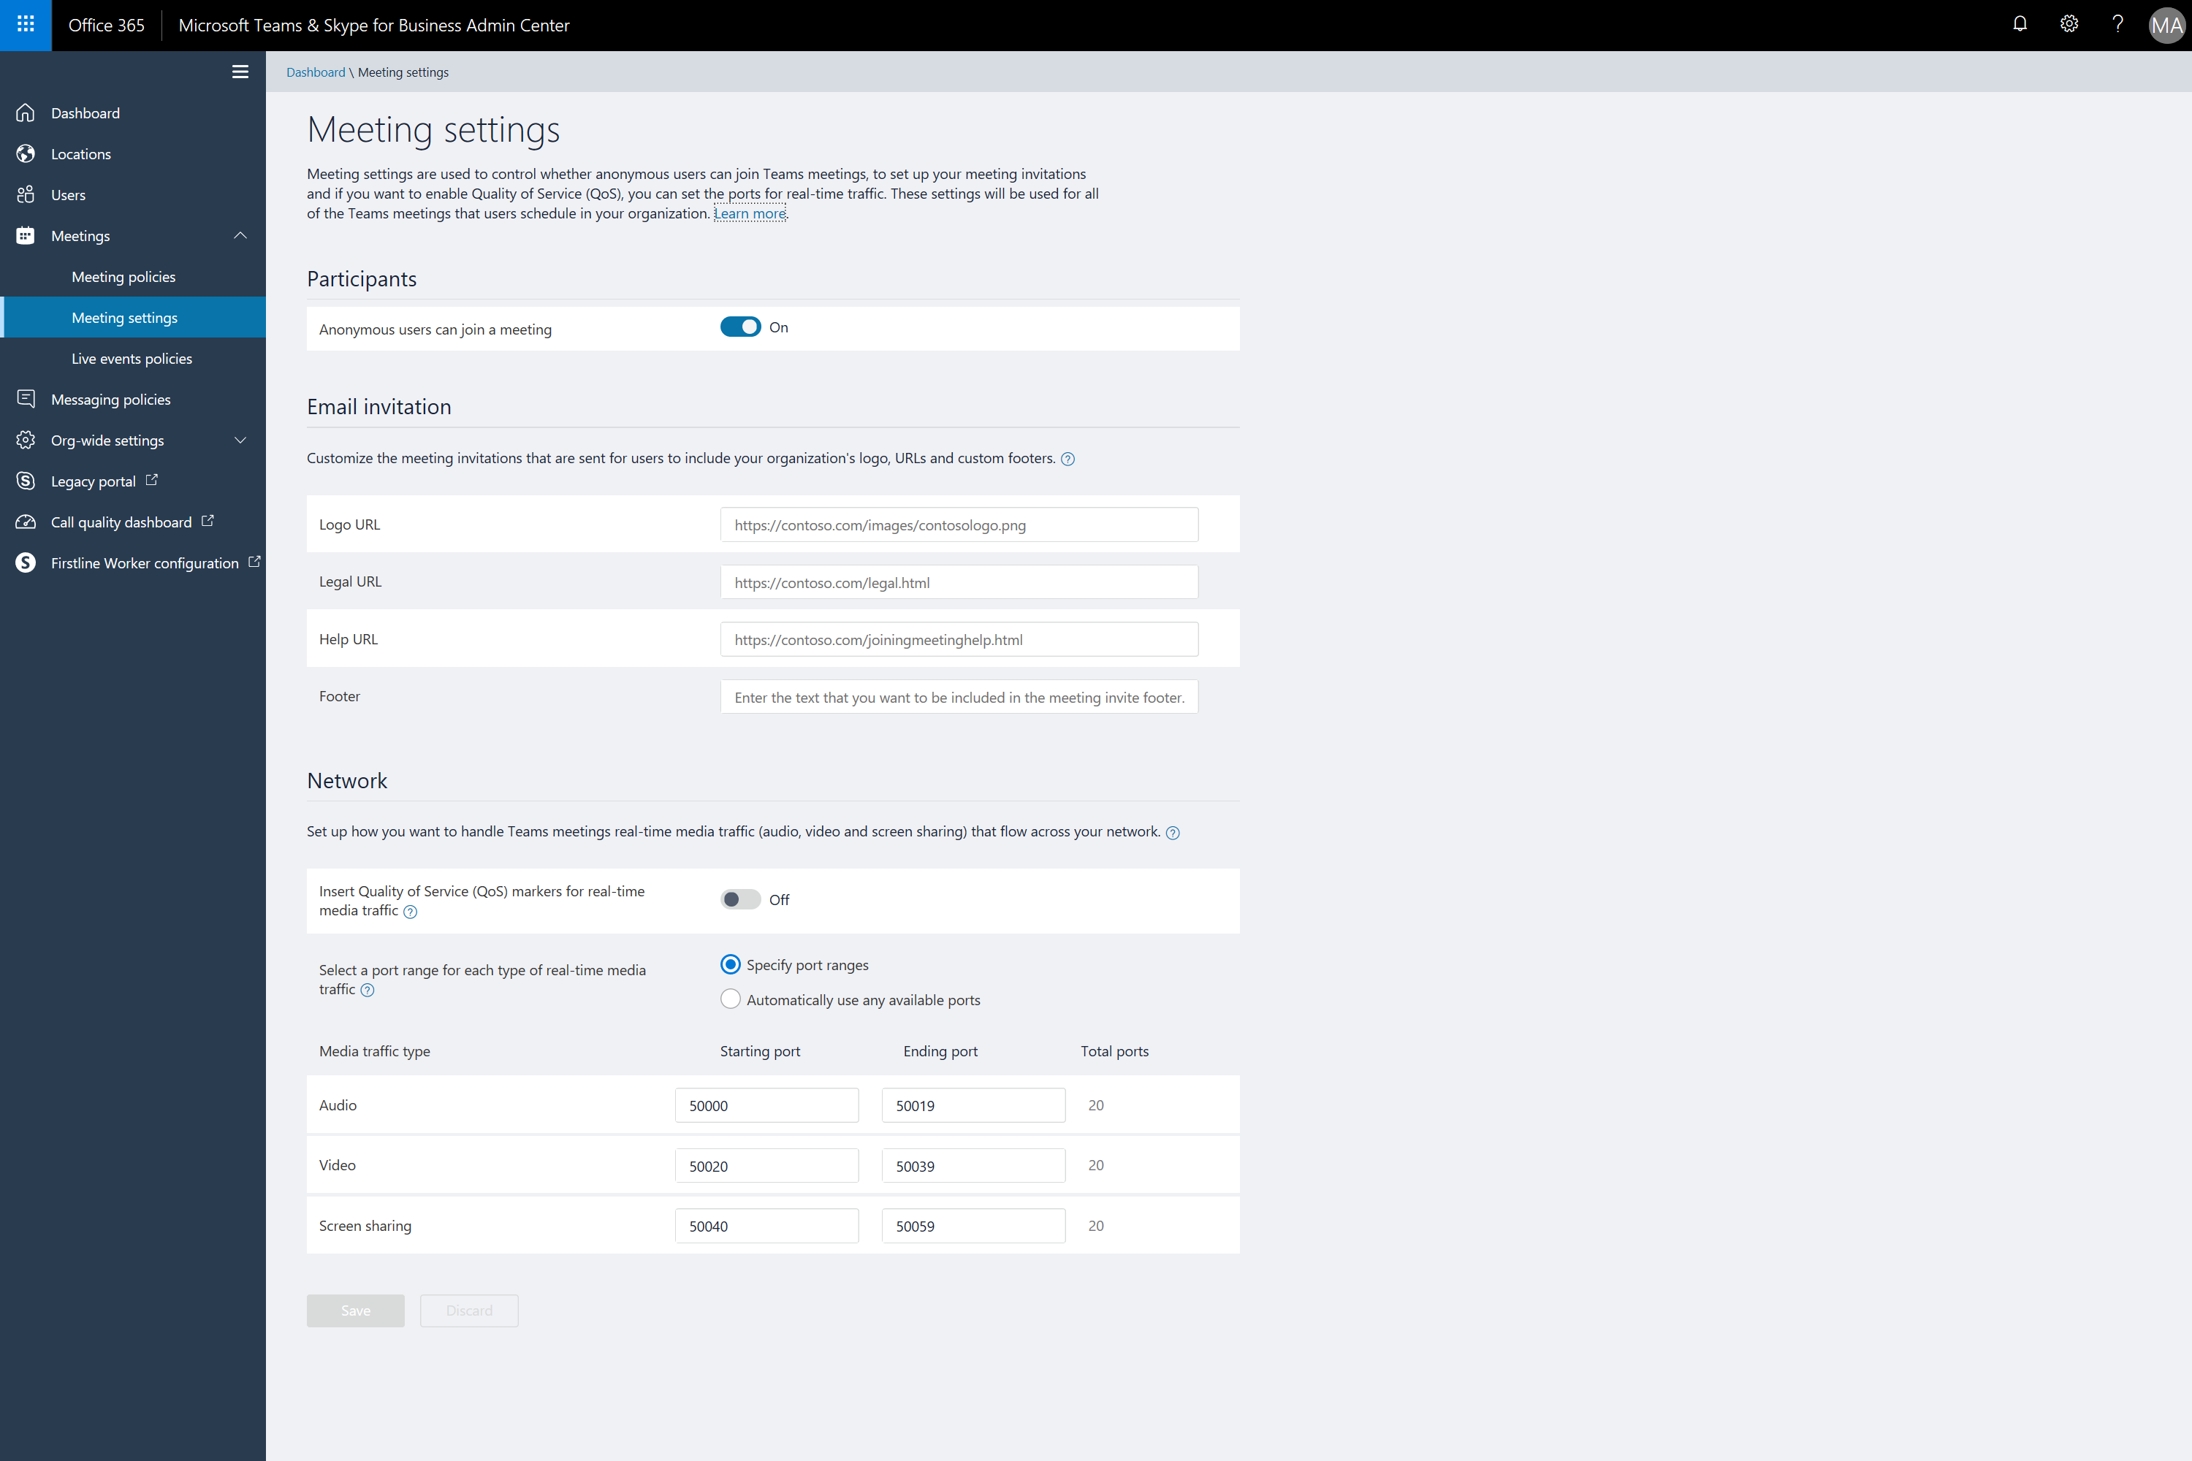
Notes:
On the Meetings setttings page we can configure:
Anonymous access
Organizational logo and URLs
Network options for media - audio, video, and screen sharing

Slide 14
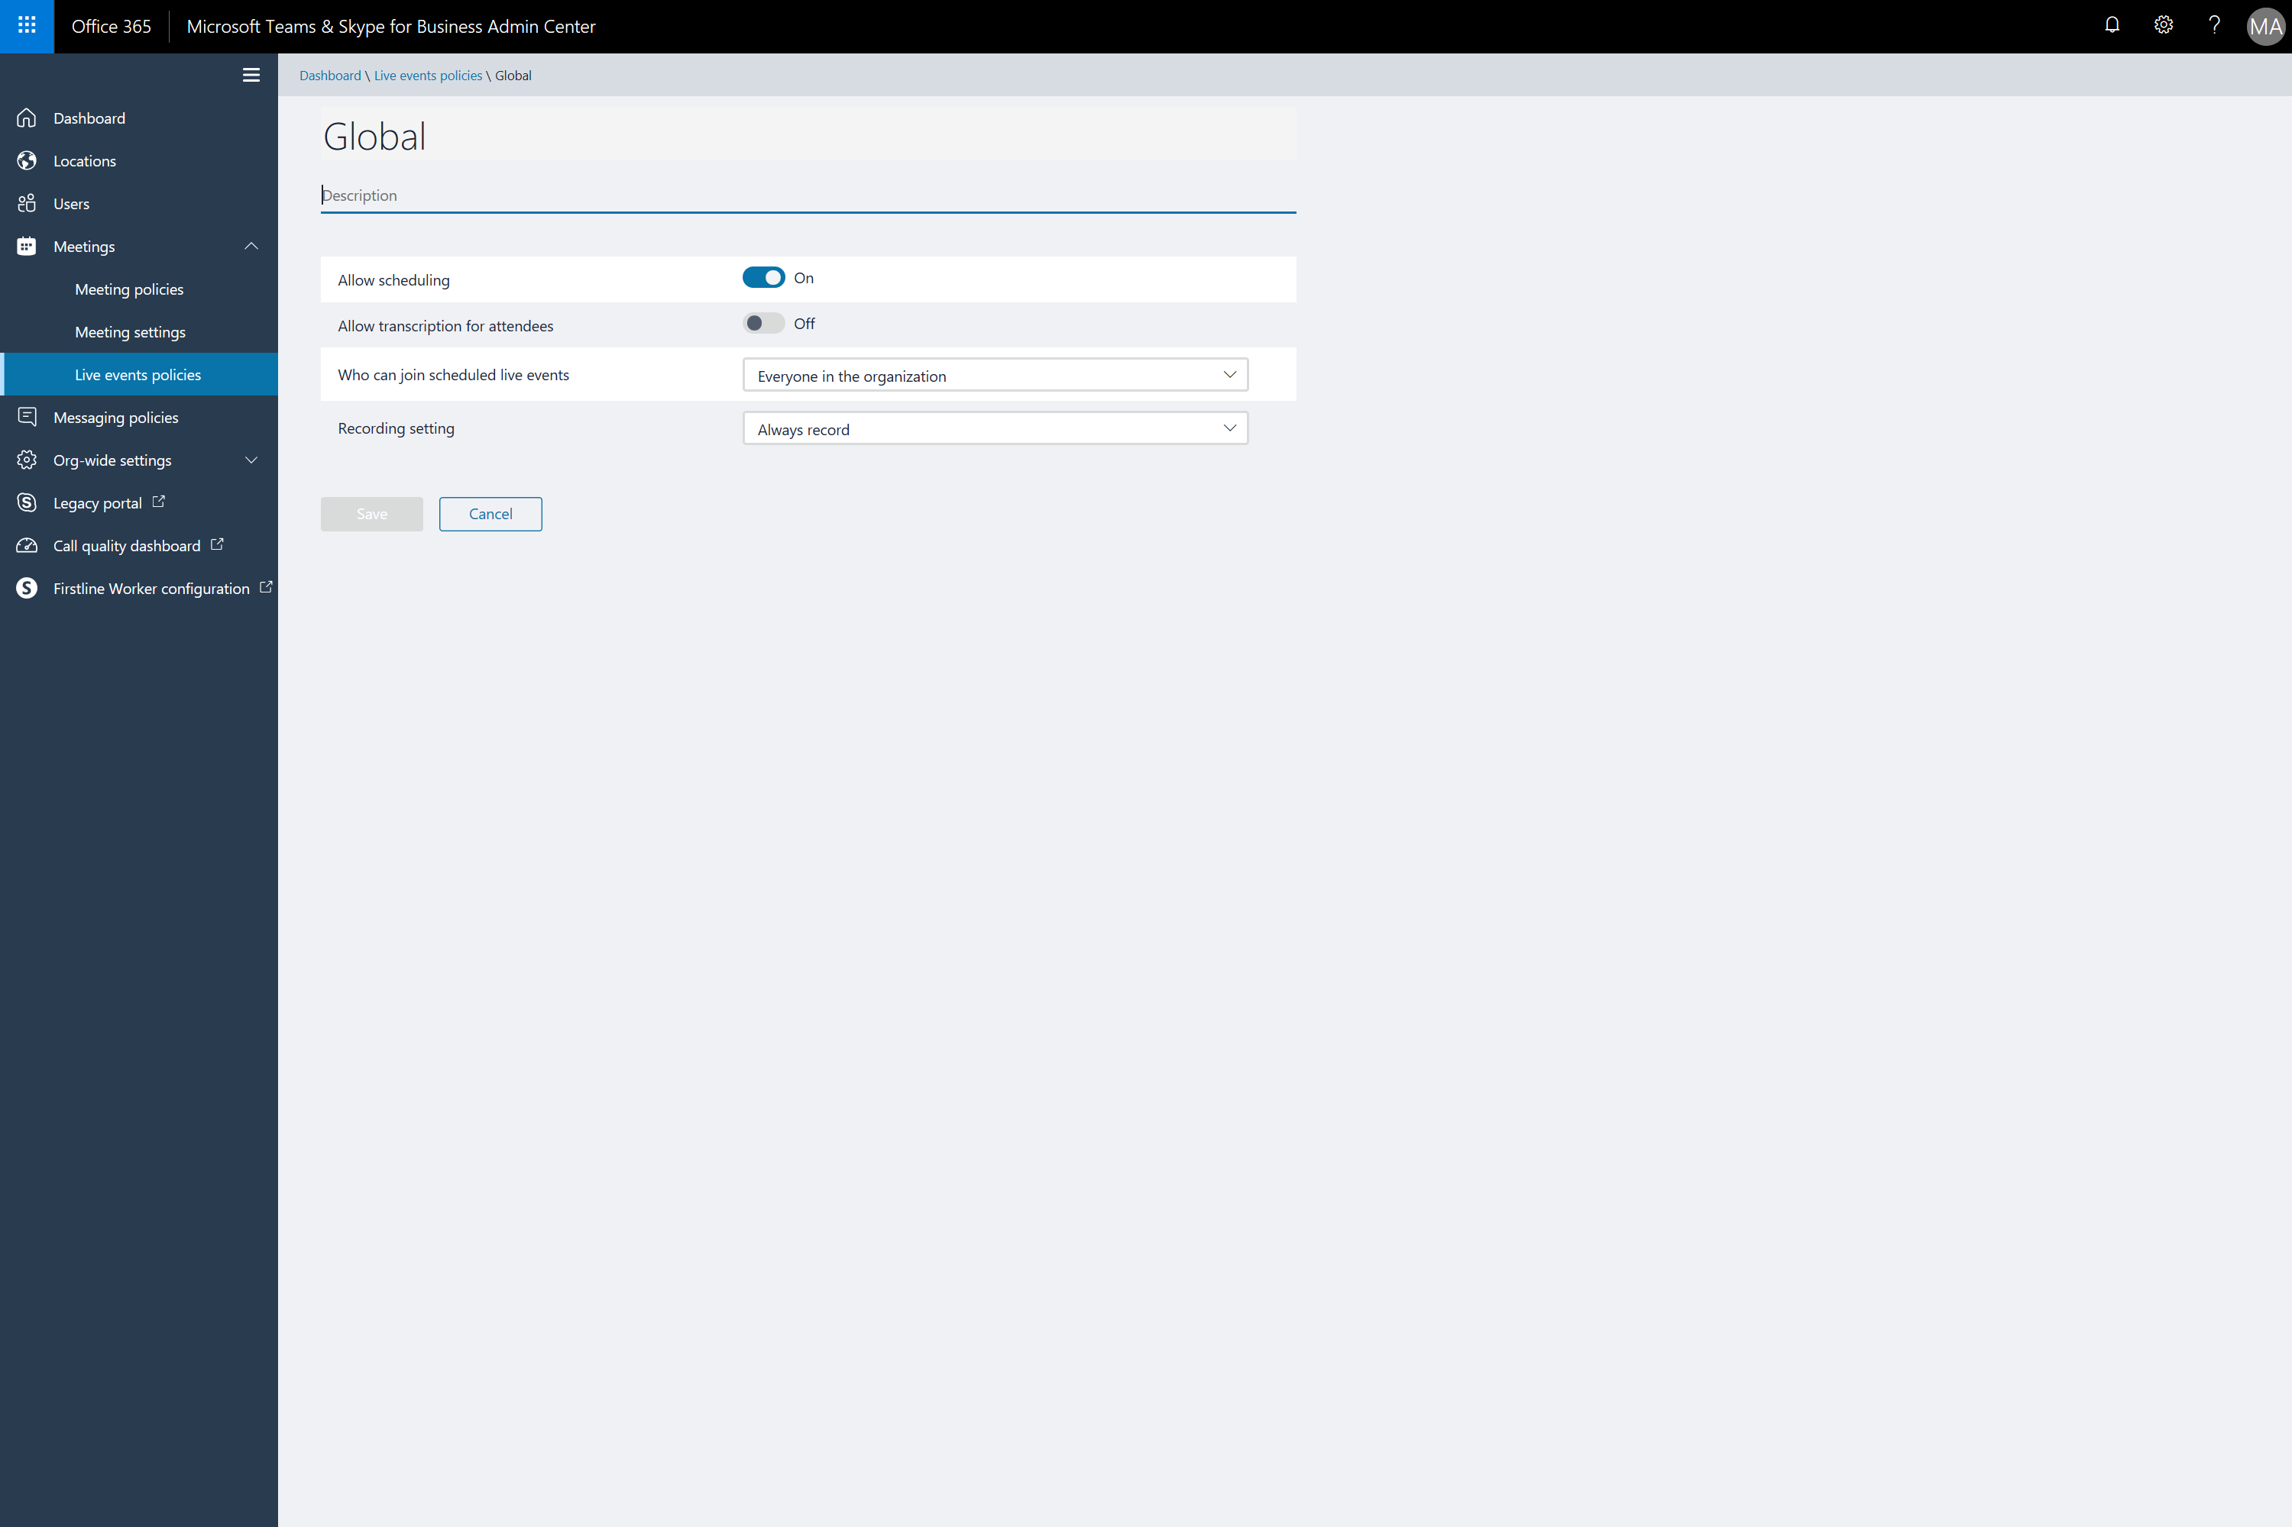
Notes:
We can configure global options for Live events or create specific policies for groups of users
The following configuration options are available
The ability to schedule live events
Transcription for attendees
Who can join
And if the live event will be recorded and upload to Stream

Slide 15
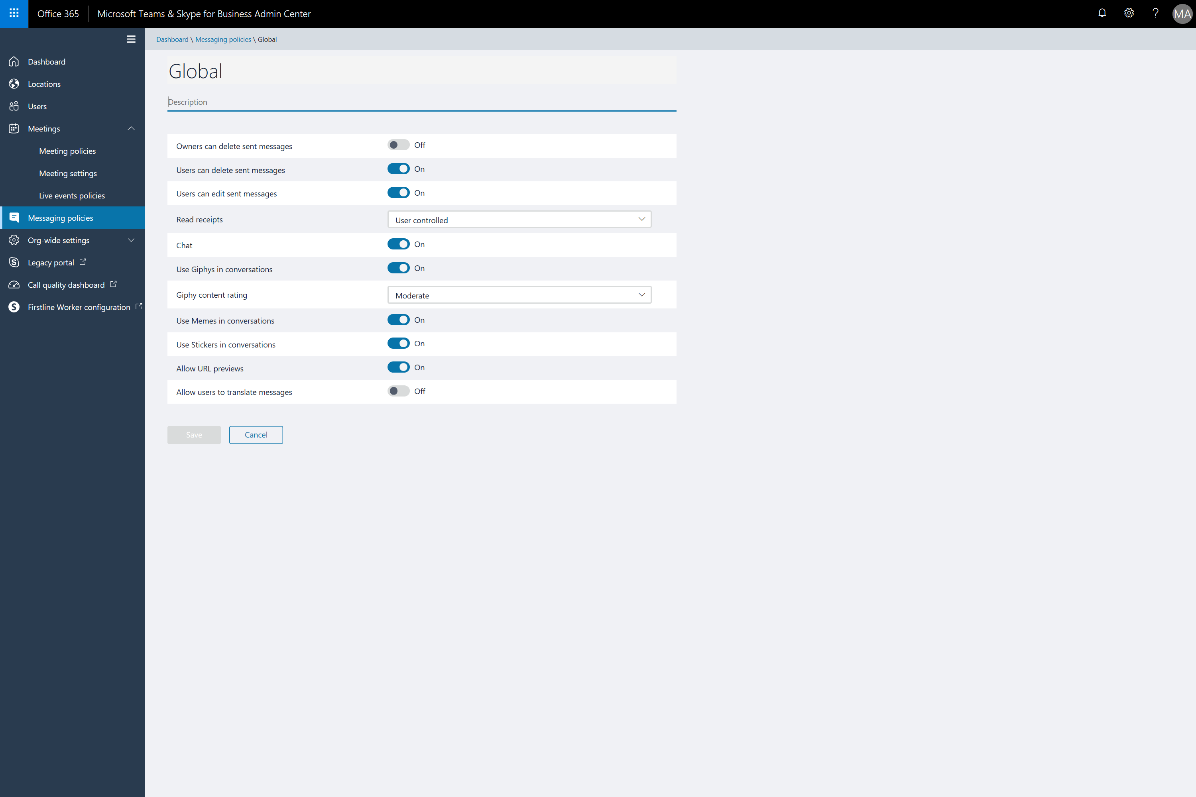
Notes:
Messaging policies are used to control what chat and channel messaging features are available to users in Teams.
You can use the default policy shown here or create one or more custom messaging policies for people in your organization.

Slide 16
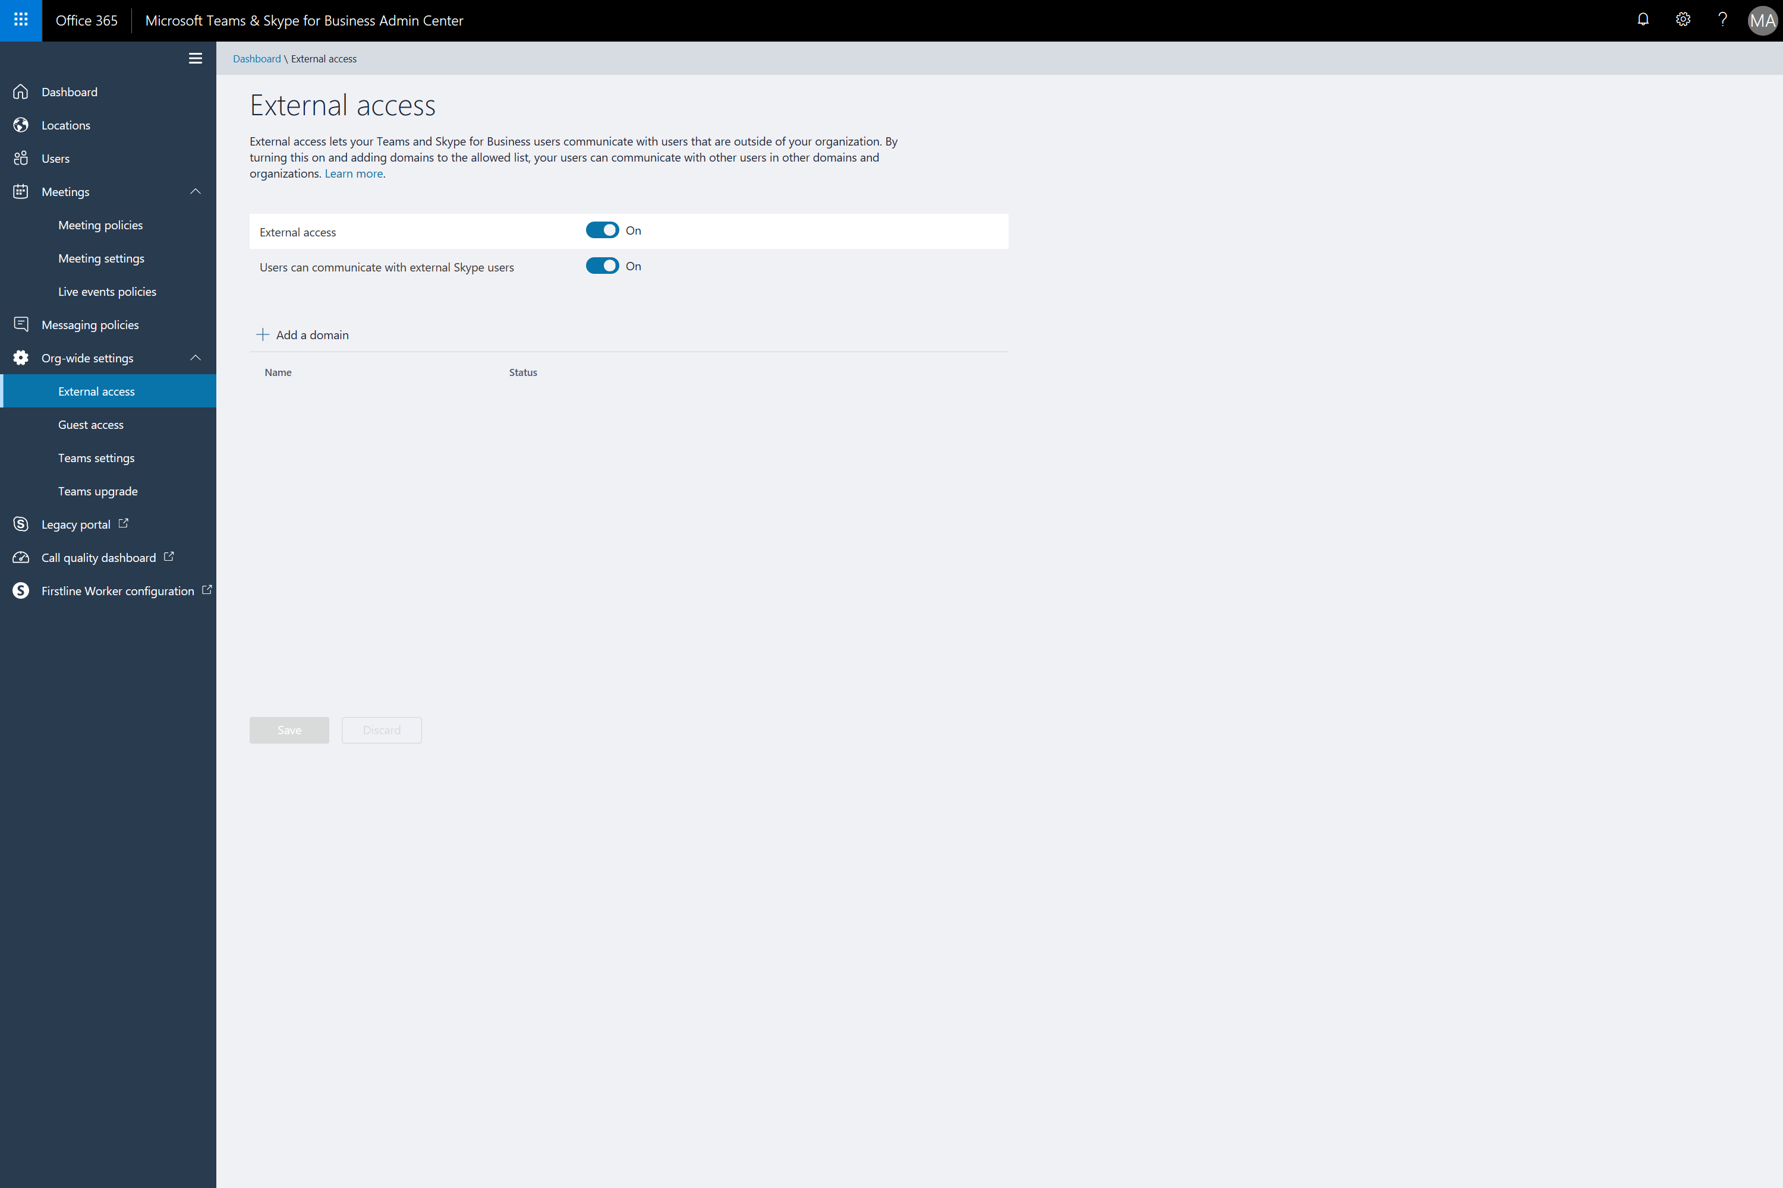
Notes:
Org wide settings allows us to configure:
External access to Teams
Guest Access
Teams settings such as Email integration and file sharing and cloud file storage options

Slide 17
Best practices for Microsoft Teams
Engage key stakeholders such as Human Resources early
Choose a committed pilot team
Emphasize chat-first scenarios
Assist with lightweight planning for team structure
Notes:
Teams provides many new collaboration and meeting capabilities so it’s important to build relationship and involve key stakeholders like HR
You need engagement and feedback from the early adopters to support organizational-wide adoption
Really focus on chat first and help get your customer comfortable with new ways of communicating
Having the team structure organized and well thought out can really help ensure Teams gets off to the best start for your customer.

Slide 18
7-Steps to onboard customers to Teams
https://aka.ms/teamspartnerkit
Line up Stakeholders
Define common use case
Establish success criteria
Create Teams
Find Teams Champs program resources
Create a communications training plan
Review progress
Notes:
Microsoft has a simplified 7-step process the helps partners quickly and easily onboard customer to Microsoft Teams at https://aka.ms/teamspartnerkit
As you can see here, most of the work is getting organized and helping the customer with adoption and change management.
The toolkit can be used to help ensure consistent, high quality Teams implementation using structured guidance and best practices from our experts in the field.

Slide 19

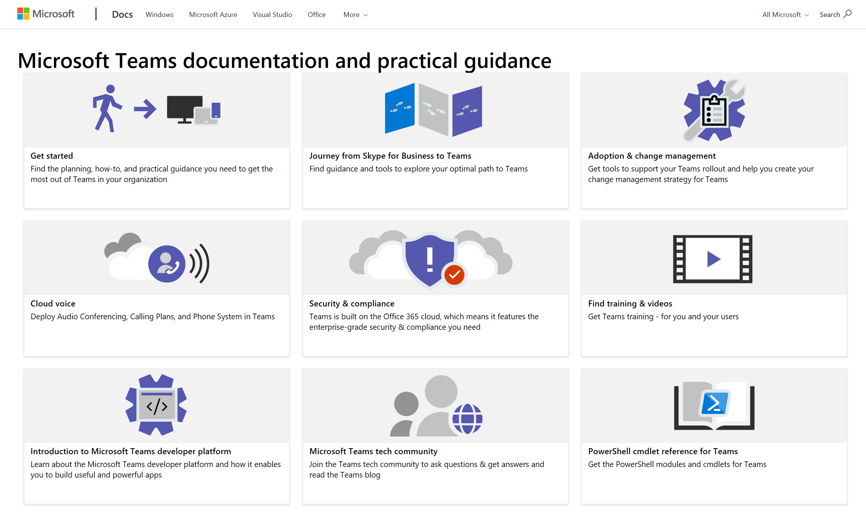
https://aka.ms/swt
Notes:
There is an assortment of Teams content and guidance at https://aka.ms/swt.
This has everything from documentation, to security and compliance guidance, to API and PowerShell reference material.
Best sure to check out the Get Started Guide as well as the training an videos first!

Slide 20
Office deployment
Pre-requisites
Methods
Device experience
Notes:
Let’s take a look at the prerequisites for deploying office to windows 10

Slide 21
What is the feature?
Office 365
Windows 10 Business devices
What it is not
Full 32-bit Office
Click to Run (C2R)
Always up-to-date
Subscription license for “BusinessRetail” package
64-bit Office Suite apps
2016 MSI standalone apps (Project, Visio, etc.)
Install for Teams
Word
Excel
PowerPoint
Publisher
Outlook
OneDrive
for Business
OneNote
Access
Teams
Notes:
Let’s begin with a quick review of the key take-aways from the earlier Getting Started session.
Microsoft 365 Business provides integrated support for Office 365 deployment and management:
It installs the latest 32-bit Office apps on Windows 10 Pro devices using Click 2 Run and keeps them up-to-date.
Office Suite apps include Word, Excel, PowerPoint, Publisher, Outlook, OneDrive for Business, OneNote, and Access, but not Teams. You will need to install that separately.
It does not include standalone apps, for example Project or Visio.
You will see the subscription license is for the Office “BusinessRetail” package
Who is it *not* for: Users that require 64-bit Office Suite apps or 2016 MSI standalone apps (Project, Visio, etc.)
<click>

Slide 22
Pre-requisites
Office 365
Pre-2016 Office
64-bit Office
Windows 10 Business activation state
Uninstall
Windows 10 Pro Creators Update
Active Microsoft 365 Business license
Device joined to Azure Active Directory
Older versions of Office (pre-2016) unless required
64-bit Office unless required
Notes:
You should also remember from the Getting Started session that there is a set of prerequisites to be aware of before you begin. The target Windows devices must be running Windows 10 Pro Creators Update, have an active Microsoft 365 Business license, and be joined to Azure Active Directory. In addition, unless required for some reason, you should uninstall any instances of 64-bit Office and/or versions prior to Office 2016.
<click>

Slide 23
Preparing for installation of Office via Click-to-Run (C2R)
Current state | Required action | What happens
No Office installed |  | System will install Office apps
Office installs via Click-to-Run (all versions) | None | Office is properly installed and licensed (32-bit and 64-bit)
Office installs via MSI (all versions) | Uninstall all MSI versions of Office | System will install Office apps once MSI versions are removed
Office ProPlus installed via Click-to-Run | None | ‘BusinessRetail’ will get installed and licensed automatically
Visio/Project apps installed via Click-to-Run or MSI | None | Office apps will install with no impact to Project/Visio
Notes:
This table details the action the end users/admins may need to take, depending on the beginning state, to have a successful 32-bit C2R version of Office deployment from the Microsoft Admin Console.
To determine whether a device is running the C2R version of Office, in any Office app, go to File > Account (Office Account in Outlook). If you see Office Updates, the installation was done by using C2R.
<click>

Slide 24
Office deployment
Pre-requisites
Methods
Device experience

Slide 25

How Office auto-deployment works
Office 365
3
Microsoft Intune
        <?xml version="1.0"?>
        <Configuration>
        <Add OfficeClientEdition="32" ForceUpgrade="TRUE" Channel="Current">
        <Product ID="O365BusinessRetail">
        <Language ID="MatchOS"/>
        </Product>
        </Add>
        <Display AcceptEULA="TRUE" Level="None"/>
        <Property Value="0" Name="SharedComputerLicensing"/>
        </Configuration>
1
MDM
2
ODT
Windows 10 Business
Upon activation, an MDM policy is delivered from Intune to the PC.
PC invokes Office Deployment Tool with config file.
Office Suite package is downloaded and installs silently.
Notes:
Before we close on Office deployment, let’s have a quick look “under the hood” at what’s actually going on. First, upon activation, an MDM policy is delivered from Microsoft MDM Provider (on the Microsoft 365 Business back end) to the target PC. The PC then invokes ODT with the config file you can see here on the right. The Office Suite package is then downloaded and installs silently. <click>

Slide 26
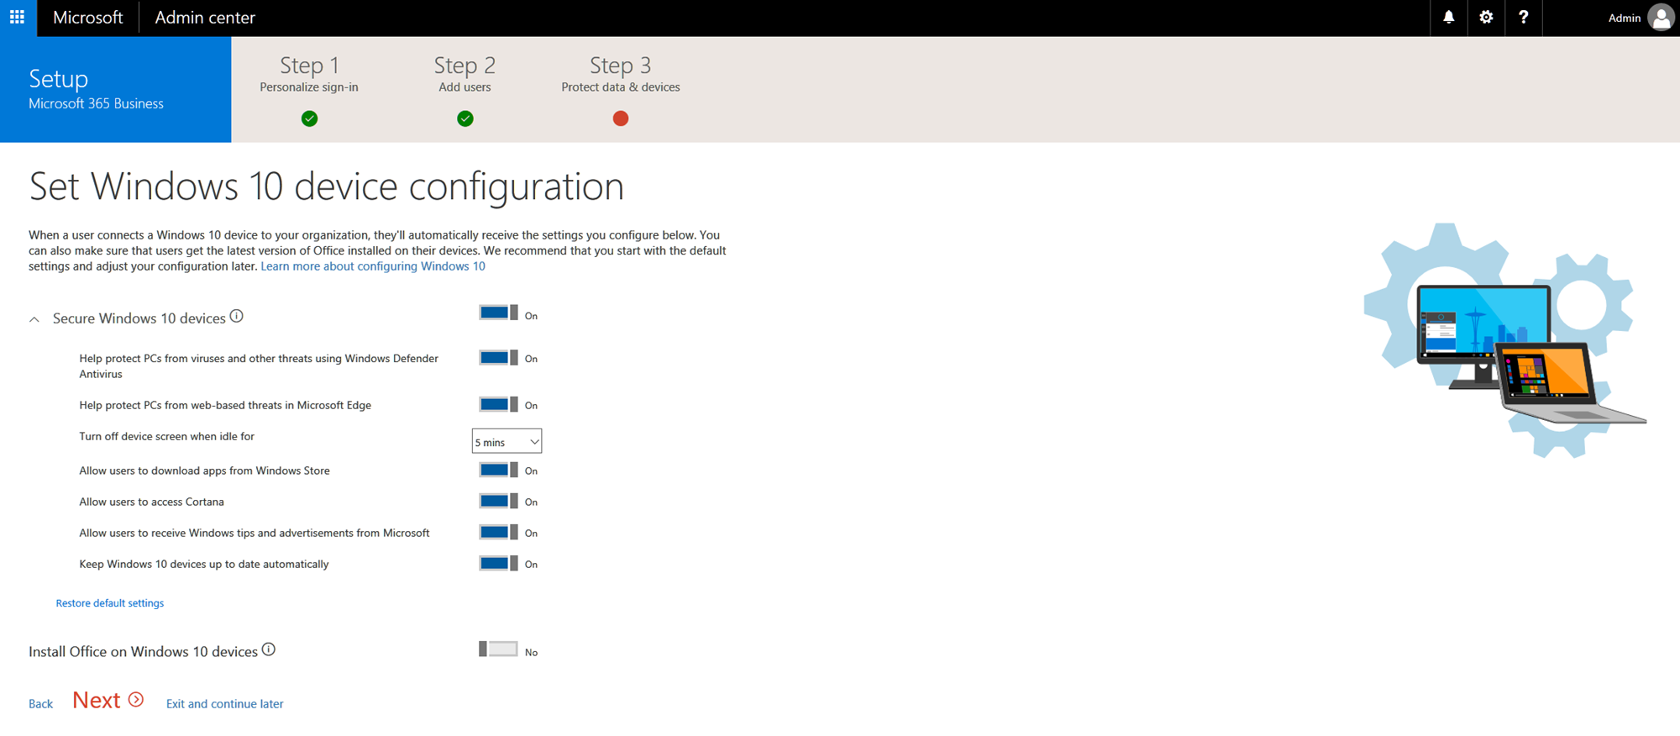
Deploying Office via the Setup Wizard
Notes:
Back in the Getting Started session, we walked through the Setup Wizard, which included the step you see here. The last toggle in the Windows 10 device configuration step allows you to automatically deploy on Windows 10 devices the Office apps that come with Microsoft 365 Business. It is off by default, but turning this setting on ensures that Office will be kept up-to-date. This is the toggle that invokes the Office Deployment Tool (ODT) to manage the install. Before Microsoft 365 Business, this level of functionality was available only via Office Enterprise E3 and higher—so this piece on its own represents great customer value for moving from Office Business Premium to Microsoft 365 Business. <click>

Slide 27
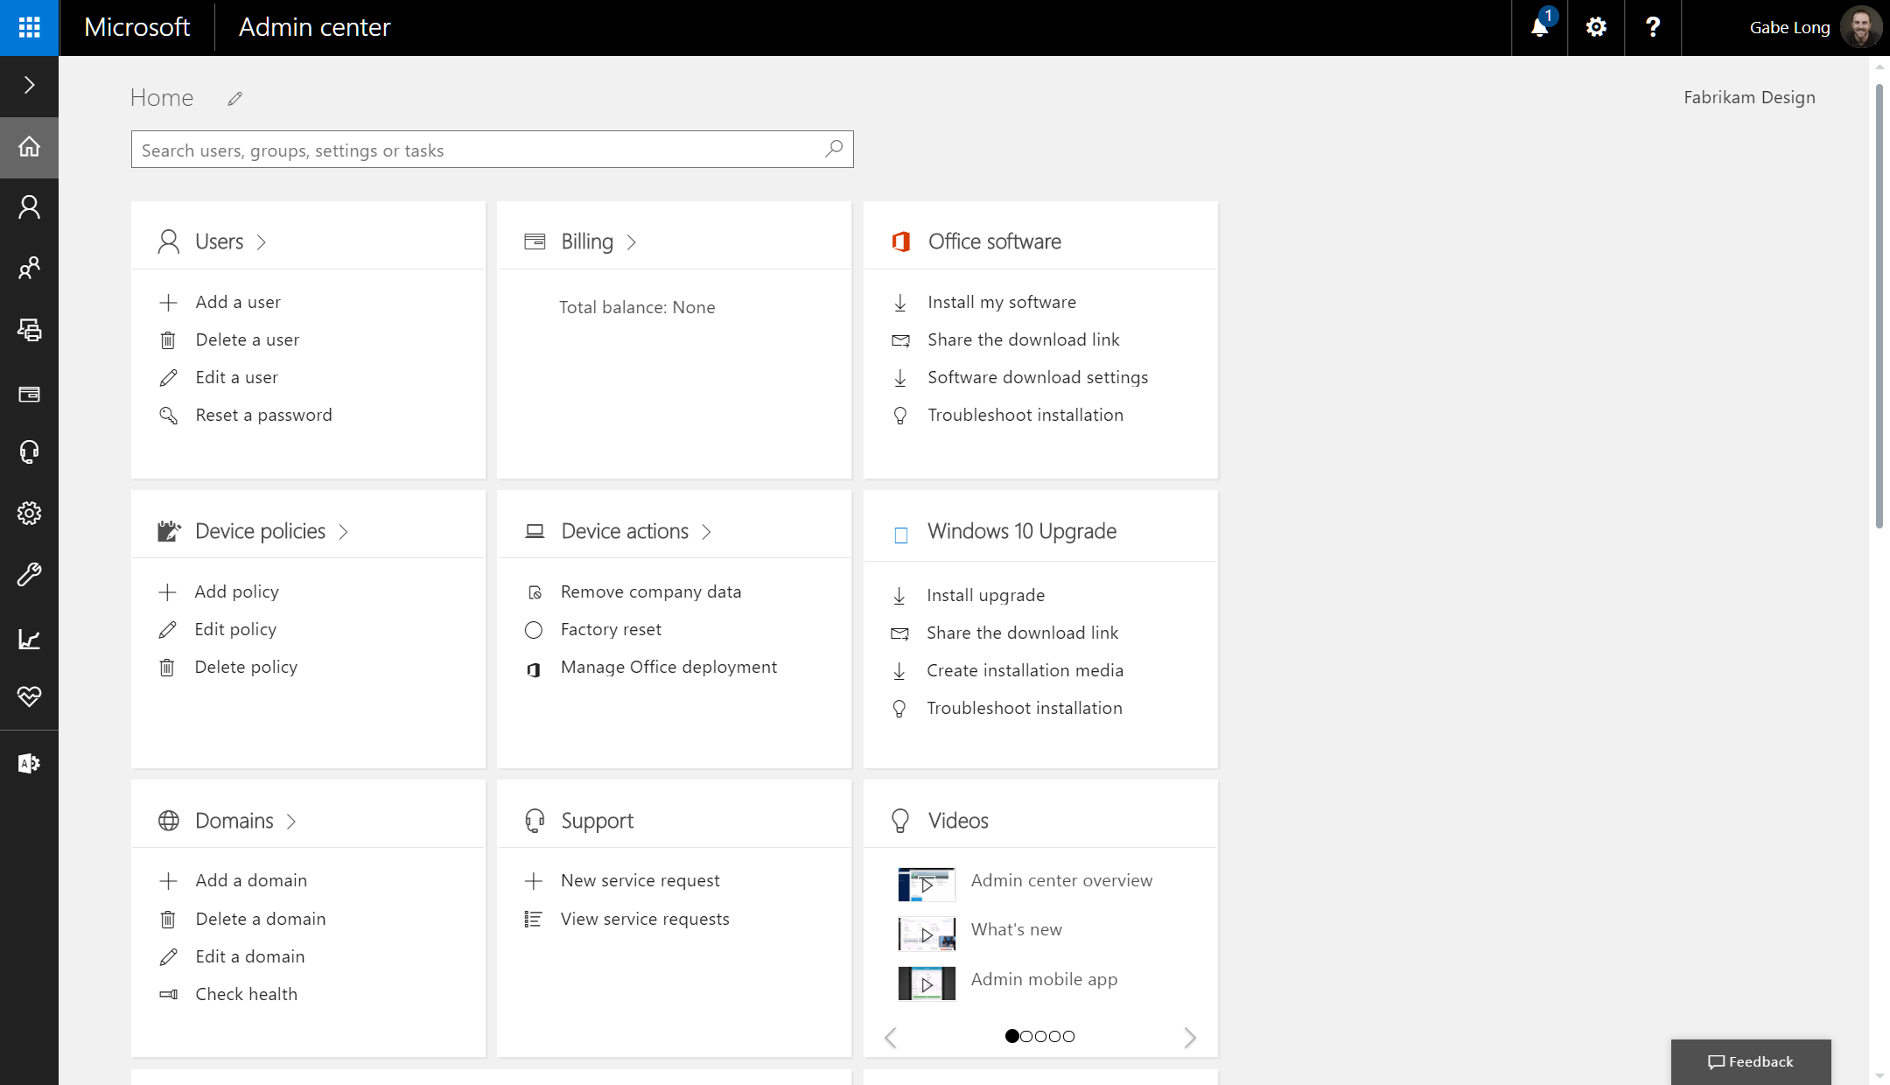
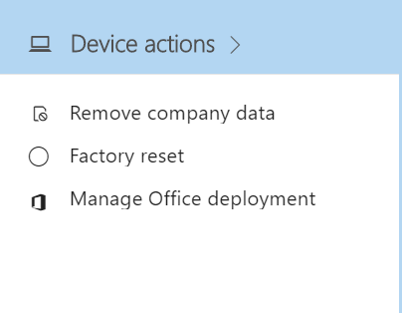
Managing Office deployment in the Admin Center
Notes:
If, during the initial setup, you didn’t set up Microsoft 365 Business to automatically deploy Office apps to users, you can do so at any time from the Admin center home page. Start by clicking Manage Office Deployment under the Devices card on the Admin center home page. <click>

Slide 28
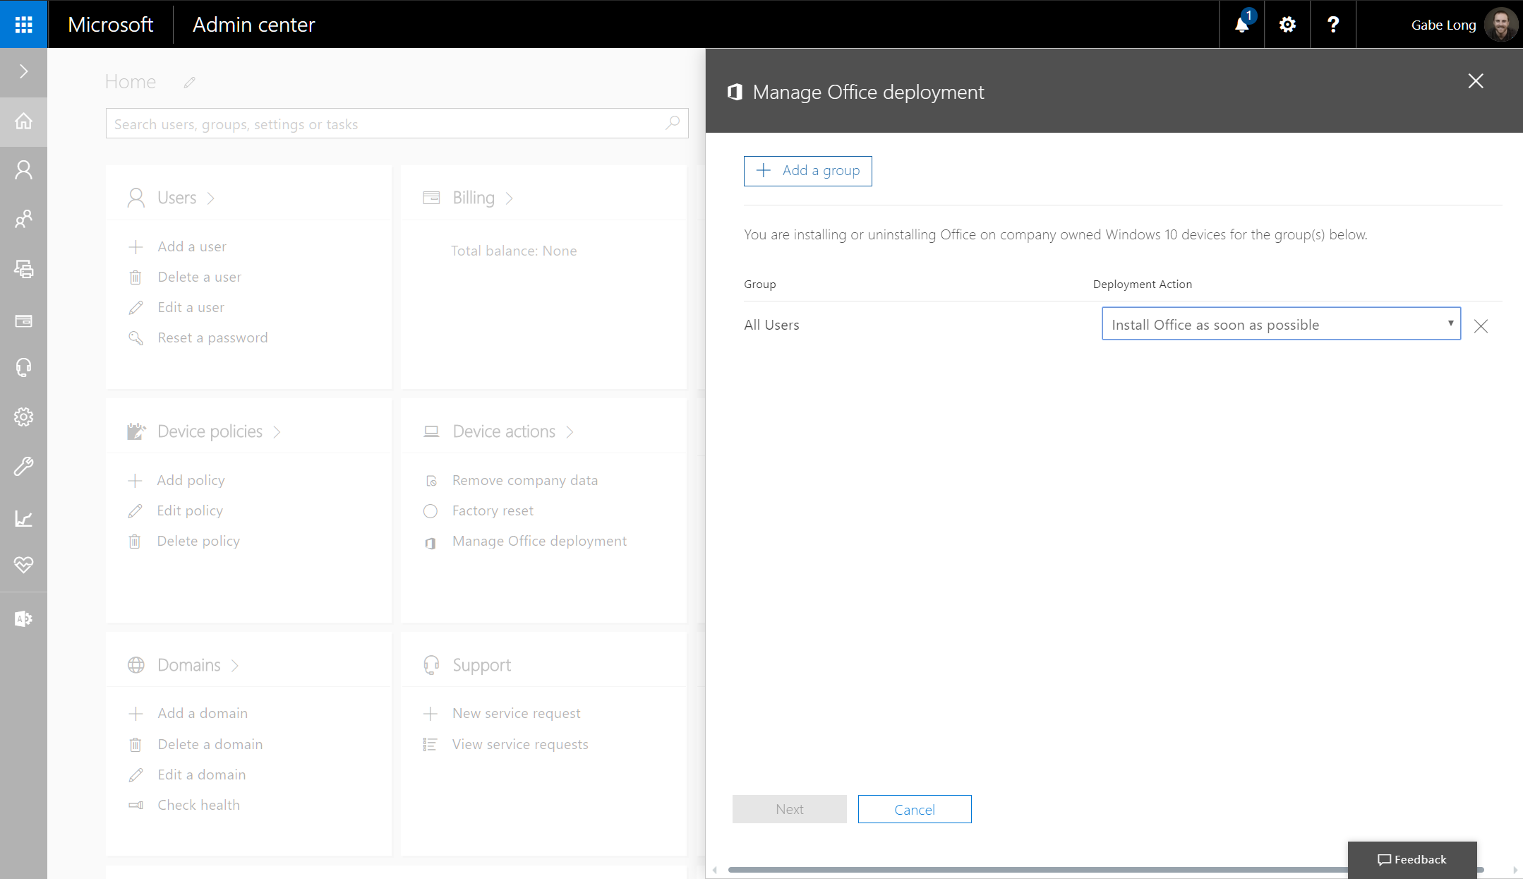
Invoking the feature
Notes:
A card pops up that allows you to quickly apply one of two settings—installing or uninstalling Office—to all users or even groups of users. To apply settings to a select group, just click the Add a group button…<click>

Slide 29
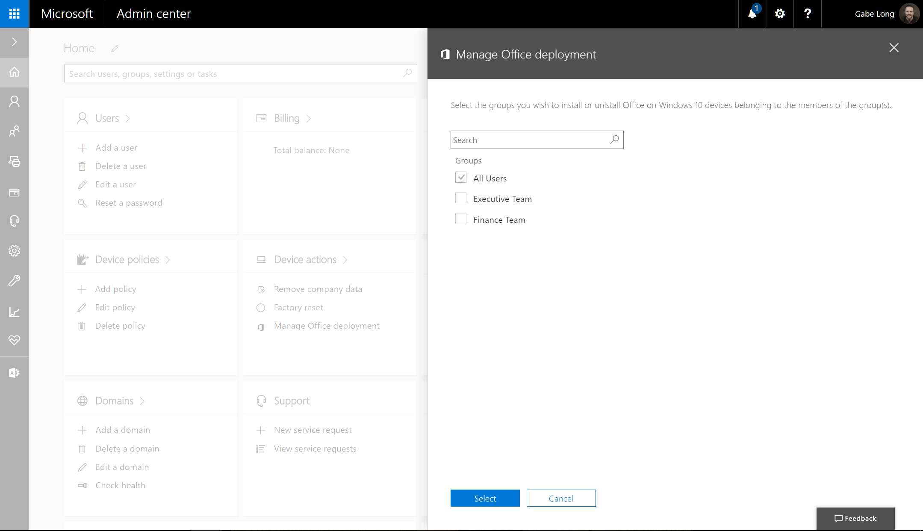
Invoking the feature
Notes:
…which pops up a new card listing the groups you previously created. Select the group, click Submit… <click>

Slide 30
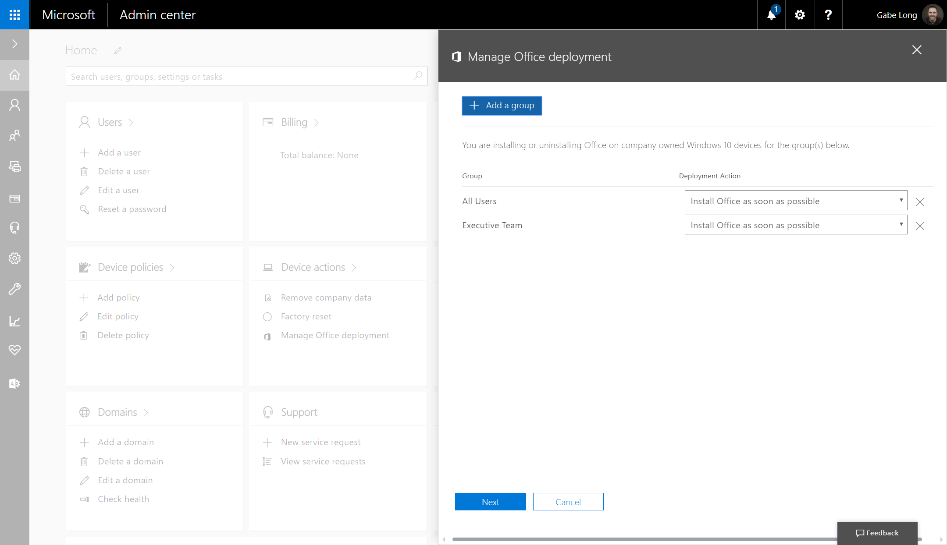
Invoking the feature
Notes:
…and then choose the desired action. <click>

Slide 31
Office deployment
Pre-requisites
Methods
Device experience
Notes:
Moving on to the final portion of module 4, we cover the Office experience on iOS and Android devices.

Slide 32
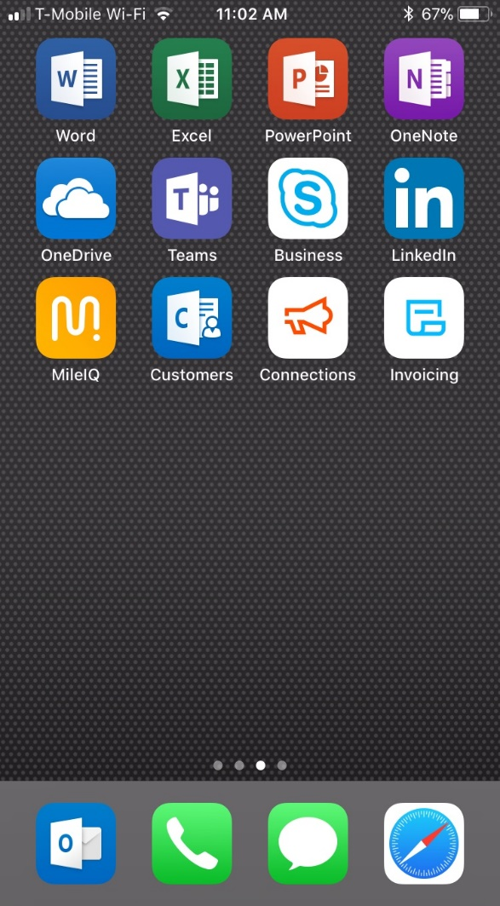
iOS setup: Step 1
User experience on an iOS device:
Step 1
Notes:
The user downloads Office 365 apps, such as Outlook, from the App Store for iOS.

Slide 33
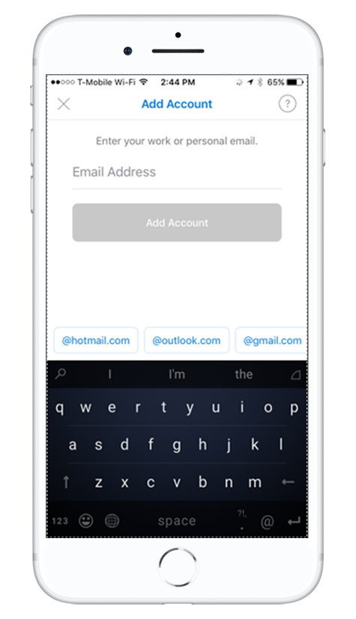

iOS setup: Step 2
User experience on an iOS device:
Step 2
Notes:
The user is prompted to sign in using company credentials.

Slide 34
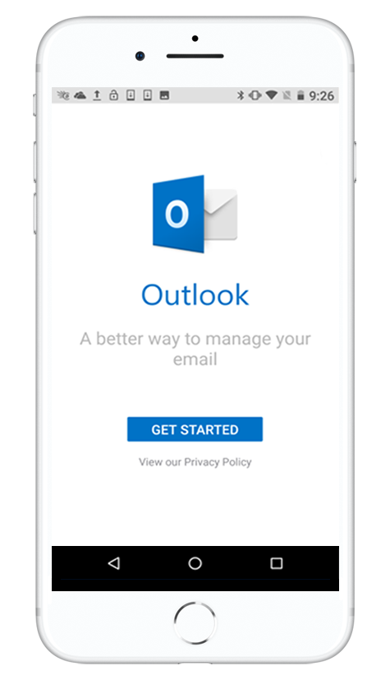
iOS setup: Step 3
User experience on an iOS device:
Step 3
Notes:
The user launches the app (in this case, Outlook) and taps Get Started.

Slide 35
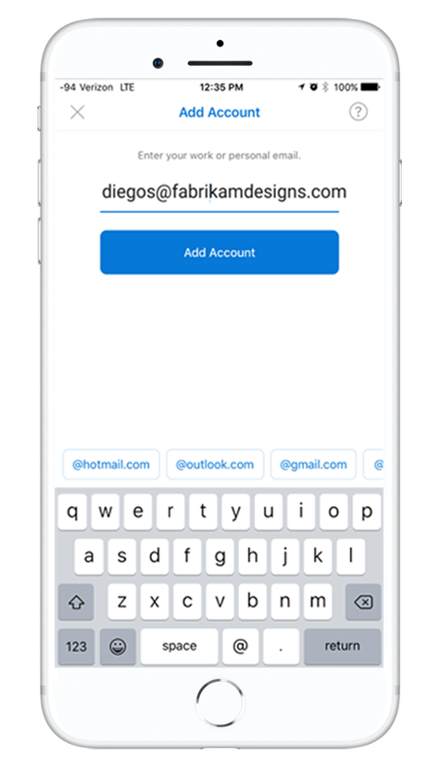
iOS setup: Step 4
User experience on an iOS device:
Step 4
Notes:
The user enters his/her company email address and then taps Add Account.

Slide 36
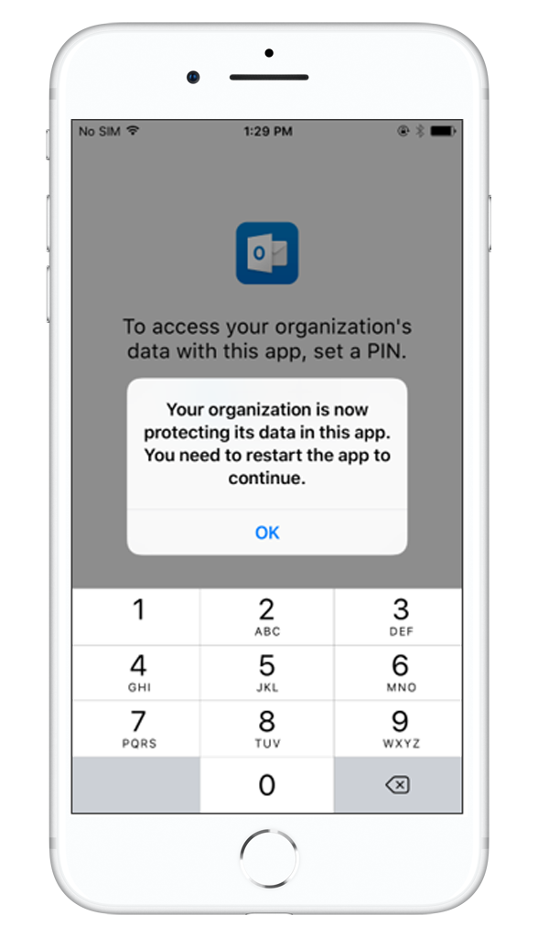
iOS setup: Step 5
User experience on an iOS device:
Step 5
Notes:
If the organization is protecting files on apps, the user will see a dialog box stating that the organization is now protecting the data in the app and that the user needs to restart the app to continue to use it. The user taps OK and closes Outlook.

Slide 37
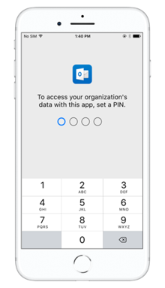
iOS setup: Step 6
User experience on an iOS device:
Step 6
Notes:
If the PIN requirement has been set to “on” during setup, when the user reopens Outlook, he/she will be prompted to enter a PIN to access the app.

Slide 38
End-user experience:
Android device initial setup
Notes:
Now let’s look at the end-user experience on an Android device.

Slide 39
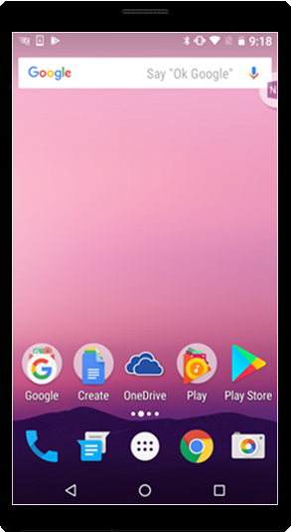
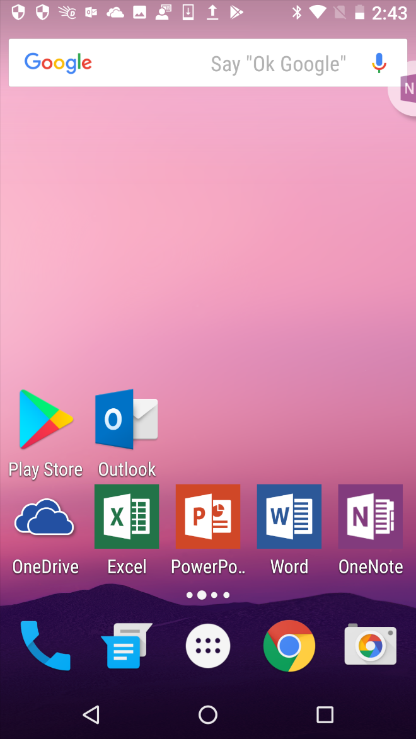
Android setup: Step 1
User experience on an Android device:
Step 1
Notes:
The user downloads Office apps from Google Play Store.

Slide 40
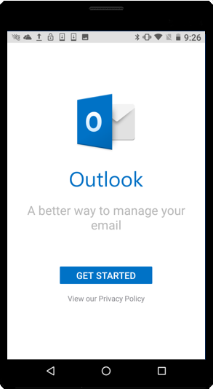
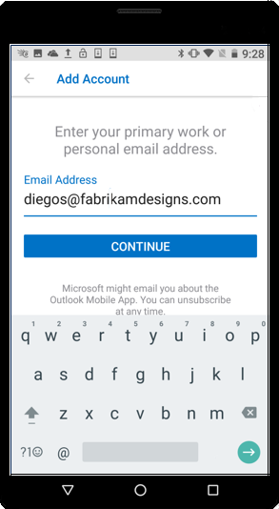
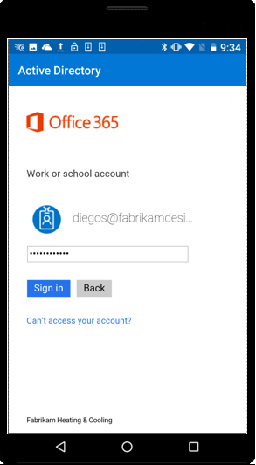
Android setup: Step 2
User experience on an Android device: Step 2
Notes:
The user launches the app (in this example, Outlook) and is prompted to sign in using company credentials.

Slide 41
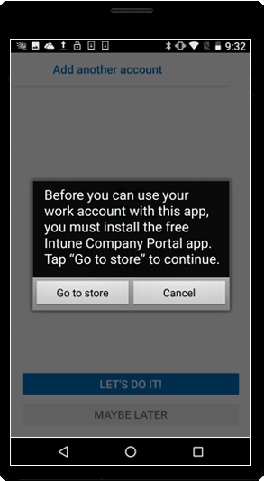
Android setup: Step 3
User experience on an Android device:
Step 3
Notes:
A dialog box then appears, advising the user to install the Company Portal app. The user then taps Go to store.

Slide 42
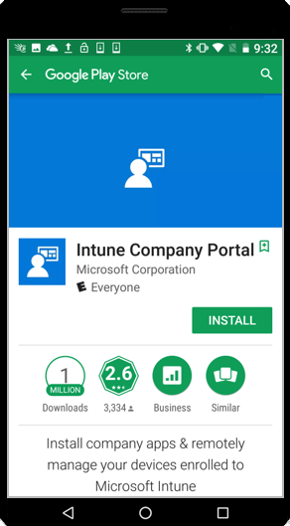
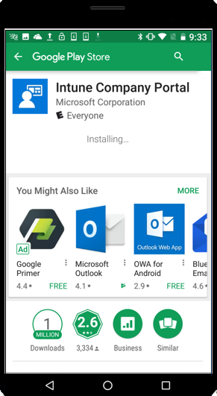
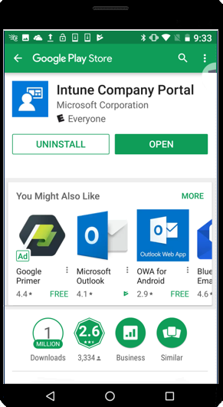
Android setup: Step 4
User experience on an Android device: Step 4
Notes:
The user installs the Company portal app. You don’t need to sign into the app, just have it installed. Once you have it downloaded, you can go back to your Outlook mobile app.

Slide 43
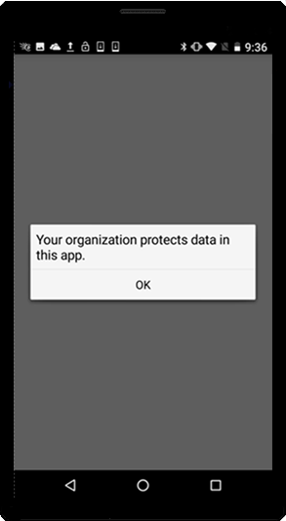
Android setup: Step 5
User experience on an Android device:
Step 5
Notes:
He/she will then see a dialog box stating that the organization protects data in this app. He or she taps OK and closes the app.
Upon reopening Outlook and signing in using company credentials, the user sees the dialog box, taps OK, and then restarts the app.

Slide 44
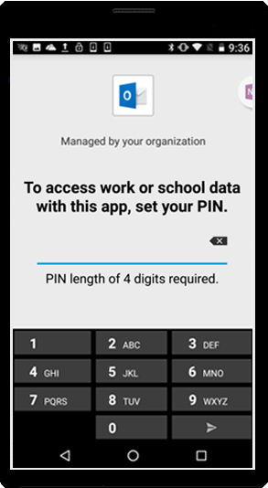
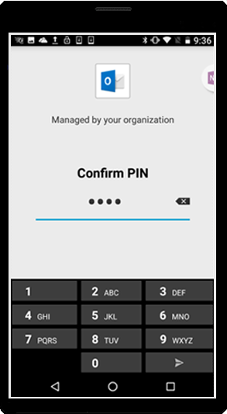
Android setup: Step 6
User experience on an Android device: Step 6
Notes:
If the PIN requirement has been set to “on” during setup, when the user reopens Outlook, he/she will be prompted to enter a PIN to access the app.

Slide 45
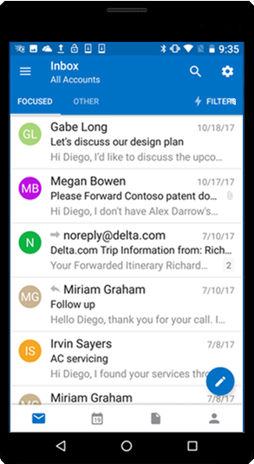
Android setup: Step 7
User experience on an Android device:
Step 7
Notes:
The user now has access to his/her Outlook mailbox and is offered a quick tutorial.

Slide 46
Key places to find content
All content that is linked through out this document can be found at these sites. It’s important to note that when in doubt, go to the Microsoft 365 Business Partner Page.
Microsoft SMB Tech Community (aka.ms/smbtc): Forum for technical discussion & questions. The place to find experts.
Microsoft 365 Business Service Description (aka.ms/M365BSD)
The place to answer all your questions on the product and what is included
Microsoft 365 Launchpad (aka.ms/partnerlaunchpad):
This the hero tool for partners to identify a solution, create and offer and close the deal with customers
Microsoft 365 Scholarship Program (https://www.microsoft.com/microsoft-365/partners/business/scholarship)
This is the campaign site for the Microsoft 365 Business Scholarship Program, running until March 30, 2019
Guided Product Tour (https://testdrive.office.com/en-us/business/small-business-solutions)
A resource for partners to take customers through product value, without needing to prepare a full demo
Licensing Deck (aka.ms/m365bld)
A resource for partners to compare different licensing SKUs
Notes:
Just a reminder that there are a variety of resources of available for Microsoft 365 Partners, covering selling and technical content.

Slide 47
Thank you
Notes:
Thank you for watching module 4, deploying Office 365.

